Slide 1


Internet of Things
(IoT)

Slide 2
Internet of Things(IoT) - Syllabus
UNIT – 2 :- IoT COMMUNICATION PROTOCOLS
Access Technologies: Physical and MAC layers, topology and Security of IEEE 802.15.4, 802.15.49, 802.15.4e, 802.11ah and Lora WAN, Network Layer: IP versions, Constrained Nodes and Constrained Networks, Application Transport Methods: Supervisory Control and Data Acquisition, Application Layer Protocols: CoAP and MQTT.
Lecture Details:
Fundamentals Of IoT
Branch: CSM
Semester: III-II

Slide 3
Cont..
IoT ACCESS TECHNOLOGIES
This unit provides an in depth look at some of access technologies that are considered for connection of smart Objects.
The following are the technologies for connecting smart objects:
IEEE 802.15.4: This is an older but foundational wireless protocol for connecting smart objects.
IEEE 802.15.4g and IEEE 802.15.4e: These are the result of improvements done to 802.15.4 and are mainly targeted to utilities and smart cities deployments.
IEEE 1901.2a: This is a technology for connecting smart objects over power lines.

Slide 4
Cont..
IoT ACCESS TECHNOLOGIES
IEEE 802.11ah: This is a technology built on the well-known 802.11 Wi-Fi standards that is specifically for smart objects.
LoRaWAN: This is a scalable technology designed for longer distances with low power requirements in the unlicensed spectrum.
NB-IoT and Other LTE Variations: These technologies are often the choice of mobile service providers looking to connect smart objects over longer distances in the licensed spectrum.

Slide 5
Cont..
IoT ACCESS TECHNOLOGIES
A common information set is provided about the IoT access technologies which are as listed below:
Standardization and alliances: The standards bodies that maintain the protocols for a technology
Physical layer: The wired or wireless methods and relevant frequencies
MAC layer: Considerations at the Media Access Control (MAC) layer, which bridges the physical layer with data link control
Topology: The topologies supported by the technology
Security: Security aspects of the technology
Competitive technologies: Other technologies that are similar and may be suitable alternatives to the given technology

Slide 6
Cont..
IEEE 802.15.4
IEEE 802.15.4 is a wireless access technology for low-cost and low-data-rate devices that are powered or run on batteries.
IEEE 802.15.4 is commonly found in the following types of deployments:
■ Home and building automation
■ Automotive networks
■ Industrial wireless sensor networks
■ Interactive toys and remote controls
This access technology enables easy installation using a compact protocol stack while remaining both simple and flexible.

Slide 7
Cont..
IEEE 802.15.4
IEEE 802.15.4 often focus on its MAC reliability, unbounded latency, and susceptibility to interference and multipath fading.
The negatives around reliability and latency often have to do with the Collision Sense Multiple Access/Collision Avoidance (CSMA/CA) algorithm.
CSMA/CA is an access method in which a device “listens” to make sure no other devices are transmitting before starting its own transmission.
If another device is transmitting, a wait time (which is usually random) occurs before “listening” occurs again.
Interference and multipath fading occur with IEEE because it lacks a frequency-hopping technique.

Slide 8
Cont..
IEEE 802.15.4
Standardization and Alliances:
Low date rate PHY and MAC layer in wireless personal networks (WPAN).
This standard have low-complexity wireless devices with low date rates with good battery life.
IEEE 802.15.4 PHY and MAC layers are the foundations for several networking protocol stacks.
a)Zigbee
b)6Lowpan
c)Zigbee IP
d)Wireless Hart
e)ISA100.11a
f)Thread

Slide 9
Cont..
IEEE 802.15.4
Standardization and Alliances:
Zigbee :Zigbee defines upper-layer components (network through application) as well as application profiles. Common profiles include building automation, home automation, and healthcare. Zigbee also defines device object functions, such as device role, device discovery, network join, & security.
6Lowpan: 6LowPAN is an IPv6 adaption layer describes how to transport IPv6 packets over IEEE 802.15.4 layers.
Zigbee IP: An evolution of the zigbee protocol stack. Zigbee IP adapts the 6LowPAN adaption layer and IPv6 network layer. In addition , it offers improvements to IP security.

Slide 10
Cont..
IEEE 802.15.4
Standardization and Alliances:
Wireless Hart: that offers time synchronized, self-organizing, & self-healing mesh architecture (about topology).
ISA100.11a: It is developed by the International society of Automation (ISA) as “wireless systems for industrial automation process control & related applications. The network and transport layers are based on IETF 6LowPAN, IPv6 & UDP standards.
Thread: Constructed on top of 6LowPAN/IPv6, Thread is a protocol stack for a secure and reliable mesh network to connect and control products in home.

Slide 11
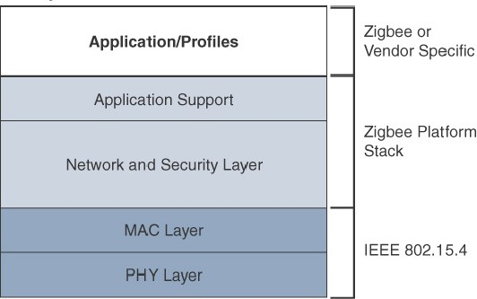
Cont..
IEEE 802.15.4-Zigbee
High Level ZigBee Protocol Stack

Slide 12
Cont..
IEEE 802.15.4-Zigbee
Zigbee utilities the 802.15.4 standard at the lower PHY and MAC layers.
It specifies the network and security layer and application support layer that sit on top of the lower layers.
The Zigbee network and security layer provides mechanisms for network startup, configuration, routing, and securing communications.
This includes calculating routing paths in what is often a changing topology, discovering neighbors, and managing the routing tables as devices join for the first time.
Network layer
For forming the appropriate topology. Which is a mesh , star or tree.
Security layer
Zigbee utilizes 802.15.4 for security at the MAC layer, using the Advanced Encryption standard (AES) with a 128-bit key & also provides security at the network & application layers

Slide 13
Cont..
IEEE 802.15.4-Zigbee
Application layer
Interfaces the lower portion of the stack dealing with the network of Zigbee devices and with the higher-layer applications.
Applications:
The main areas where ZigBee is the most well-known include automation for commercial, retail, and home applications and smart energy.
In the industrial and commercial automation space, ZigBee-based devices can handle various functions, from measuring temperature and humidity to tracking assets.
For home automation, ZigBee can control lighting, thermostats, and security functions

Slide 14
Cont..
IEEE 802.15.4-Zigbee IP
Zigbee IP
IEEE 802.15.4, IP and TCP/UDP protocols and various other open standards are supported at the network and transport layers.
Open standards like LLNs, IPv6, 6LowPAN and RPL. These providers for low bandwidth, low-power and cost- effective communications when connecting smart objects.
Zigbee IP Applications like
Smart Energy (SE) profile 2.0 or SE 2.0.
Smart metering and residential energy management systems.

Slide 15
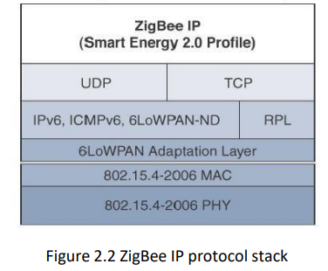
Cont..
IEEE 802.15.4-Zigbee IP

Slide 16
Cont..
IEEE 802.15.4-Zigbee IP
6LowPAN as an Adaptation layer:
Zigbee IP utilizes the mesh-over or route-over method for forwarding packets.
It supports of 6LowPAN’s fragmentation and header compression schemes.
Network layer
Support IPv6, ICMPv6 (Internet control message protocol version 6) and 6LowPAN (over low-power wireless personal area network) Neighbor Discovery(ND), and utilize RPL (recognition of prior learning) for the routing of packets across the mesh network.
Both TCP and UDP are also supported, to provide both connection-oriented and connection-less service.

Slide 17
Cont..
IEEE 802.15.4
Physical layer:
The 802.15.4 standard supports an extensive number of PHY options that range from 2.4 GHz to sub-GHz frequencies in ISM bands.
These standards is based on DSSS( direct sequence spread spectrum), is a modulation technique in which a signal is intentionally spread in the frequency domain, resulting in greater bandwidth.
The original physical layer transmission options were as follows:
■ 2.4 GHz, 16 channels, with a data rate of 250 kbps
■ 915 MHz, 10 channels, with a data rate of 40 kbps
■ 868 MHz, 1 channel, with a data rate of 20 kbps
You should note that only the 2.4 GHz band operates worldwide.

Slide 18
Cont..
IEEE 802.15.4
Physical layer:
Additional PHY communication options are:
■ OQPSK PHY: This is DSSS PHY, employing offset quadrature phase-shift keying (OQPSK) modulation. OQPSK is a modulation technique that uses four unique bit values that are signalled by phase changes. An offset function that is present during phase shifts allows data to be transmitted more reliably.
■ BPSK PHY: This is DSSS PHY, employing binary phase-shift keying (BPSK) modulation. BPSK specifies two unique phase shifts as its data encoding scheme.
■ ASK PHY: This is parallel sequence spread spectrum (PSSS) PHY, employing amplitude shift keying (ASK) and BPSK modulation. PSSS is an advanced encoding scheme that offers increased range, throughput, data rates, and signal integrity compared to DSSS. ASK uses amplitude shifts instead of phase shifts to signal different bit values.
These improvements increase the maximum date rate.

Slide 19
Cont..
IEEE 802.15.4
Physical layer:
Figure shows the frame for the 802.15.4 physical layer. The synchronization header for this frame is composed of the Preamble and the Start of Frame Delimiter fields.
The Preamble field is a 32-bit 4-byte (for parallel construction) pattern that identifies the start of the frame and is used to synchronize the data transmission.
The PHY Header portion of the PHY frame shown in Figure is simply a frame length value. It lets the receiver know how much total data to expect in the PHY service data unit (PSDU) portion of the 802.4.15 PHY.
The PSDU is the data field or payload.
The Start of Frame Delimiter field informs the receiver that frame contents start immediately after this byte

Slide 20
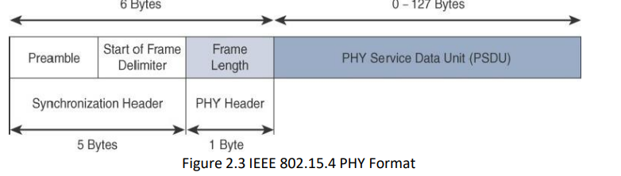
Cont..
IEEE 802.15.4
Physical layer:

Slide 21
Cont..
IEEE 802.15.4
MAC layer:
The IEEE 802.15.4 MAC layer manages access to the PHY channel by defining how devices in the same area will share the frequencies allocated.
At this layer, the scheduling and routing of data frames are also coordinated.
The 802.15.4 MAC layer performs the following tasks:
• Network beaconing for devices acting as coordinators (New devices use beacons to join an 802.15.4 network)
• PAN association and disassociation by a device
• Device security
• Reliable link communications between two peer MAC entities

Slide 22
Cont..
IEEE 802.15.4
MAC layer:
The MAC layer achieves these tasks by using various predefined frame types. In fact, four types of MAC frames are specified in 802.15.4:
• Data frame: Handles all transfers of data
• Beacon frame: Used in the transmission of beacons from a PAN coordinator
• Acknowledgement frame: Confirms the successful reception of a frame
•MAC command frame: Responsible for control communication between devices
Each of these four 802.15.4 MAC frame types follows the frame format shown in Figure. In Figure , notice that the MAC frame is carried as the PHY payload. The 802.15.4 MAC frame can be broken down into the MAC Header, MAC Payload, and MAC Footer fields.
The MAC payload field varies by individual frame type, maximum payload is 127 bytes, and also defines how a 16-bit “short address” is assigned to devices.

Slide 23
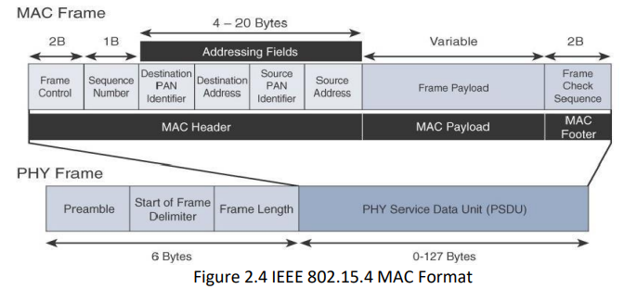
Cont..
IEEE 802.15.4
MAC layer:

Slide 24
Cont..
IEEE 802.15.4
Topology:
IEEE 802.15.4–based networks can be built as star, peer-to-peer, or mesh topologies. Mesh networks tie together many nodes.
This allows nodes that would be out of range if trying to communicate directly to leverage intermediary nodes to transfer communications.
Every 802.15.4 PAN should be set up with a unique ID. All the nodes in the same 802.15.4 network should use the same PAN ID. Figure shows an example of an 802.15.4 mesh network with a PAN ID of 1.

Slide 25
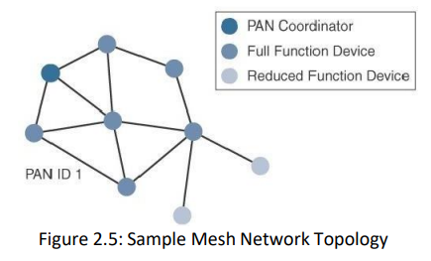
Cont..
IEEE 802.15.4
Topology:

Slide 26
Cont..
IEEE 802.15.4
Topology:
A minimum of one FFD acting as a PAN coordinator is required to deliver services that allow other devices to associate and form a cell or PAN.
Notice in Figure that a single PAN coordinator is identified for PAN ID 1. FFD devices can communicate with any other devices, whereas RFD devices can communicate only with FFD devices.
The IEEE 802.15.4 specification does not define a path selection within the MAC layer for a mesh topology. This function can be done at Layer 2 and is known as mesh-under. Generally, this is based on a proprietary solution.
Alternatively, the routing function can occur at Layer 3, using a routing protocol, such as the IPv6 Routing Protocol for Low Power and Lossy Networks (RPL).
This is referred to as mesh-over.

Slide 27
Cont..
IEEE 802.15.4
Security:
The IEEE 802.15.4 specification uses Advanced Encryption Standard (AES) with a 128- bit key length as the base encryption algorithm for securing its data and also validates the data that is sent.
Validation is accomplished by a message integrity code (MIC), which is calculated for the entire frame using the same AES key that is used for encryption.
AES is a block cipher, which means it operates on fixed-size blocks of data.

Slide 28
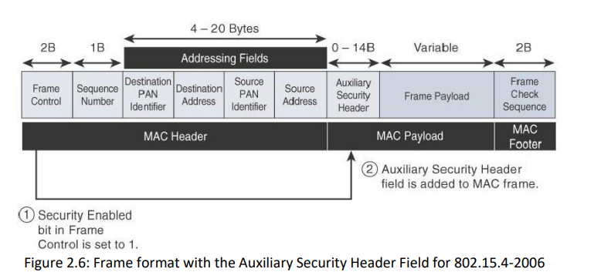
Cont..
IEEE 802.15.4
Security:

Slide 29
Cont..
IEEE 802.15.4
Security:
Enabling these security features for 802.15.4 changes the frame format slightly and consumes some of the payload.
Using the Security Enabled field in the Frame Control portion of the 802.15.4 header is the first step to enabling AES encryption.
This field is a single bit that is set to 1 for security. Once this bit is set, a field called the Auxiliary Security Header is created after the Source Address field, by stealing some bytes from the Payload field.
Figure shows the IEEE 802.15.4 frame format at a high level, with the Security Enabled bit set and the Auxiliary Security Header field present.

Slide 30
Cont..
IEEE 802.15.4
Competitive Technologies:
A competitive radio technology that is different in its PHY and MAC layers is DASH7.
Commonly employed in active radio frequency identification (RFID) implementations, DASH7 was used by US military forces for many years, mainly for logistics purposes.
The current DASH7 technology offers low power consumption, a compact protocol stack, range up to 1 mile, and AES encryption.
Frequencies of 433 MHz, 868 MHz, and 915 MHz have been defined, enabling data rates up to 166.667 kbps and a maximum payload of 256 bytes.
DASH7 is promoted by the DASH7 Alliance, which has evolved the protocol from its active RFID niche into a wireless sensor network technology that is aimed at the commercial market.

Slide 31
Cont..
IEEE 802.15.4g and 802.15.4e
The IEEE 802.15.4e amendment of 802.15.4-2011 expands the MAC layer feature set to remedy the disadvantages associated with 802.15.4, including MAC reliability, unbounded latency, and multipath fading.
In addition to making general enhancements to the MAC layer, IEEE 802.15.4e also made improvements to better cope with certain application domains, such as factory and process automation and smart grid.
IEEE 802.15.4e-2012 enhanced the IEEE 802.15.4 MAC layer capabilities in the areas of frame format, security, determinism mechanism (detection of changes), and frequency hopping.

Slide 32
Cont..
IEEE 802.15.4g and 802.15.4e
IEEE 802.15.4g-2012 is also an amendment to the 802.15.4-2011 standard, and just like 802.15.4e-2012, it has been fully integrated into the core IEEE 802.15.4-2015 specification.
The focus of this specification is the smart grid or, more specifically, smart utility network communication.
802.15.4g seeks to optimize large outdoor wireless mesh networks for field area networks (FANs). New PHY definitions are introduced, as well as some MAC modifications needed to support their implementation.

Slide 33
Cont..
IEEE 802.15.4g and 802.15.4e
This technology applies to IoT use cases such as the following:
■ Distribution automation and industrial supervisory control and data acquisition (SCADA) environments for remote monitoring and control
■ Public lighting
■ Environmental wireless sensors in smart cities
■ Electrical vehicle charging stations
■ Smart parking meters
■ Microgrids
■ Renewable energy

Slide 34
Cont..
IEEE 802.15.4g and 802.15.4e
Standardization and Alliances:
The additional capabilities and options provided by 802.15.4g-2012 and 802.15.4e-2012 led to additional difficulty in achieving the interoperability between devices and mixed vendors that users requested.
To guarantee interoperability, the Wi-SUN Alliance was formed.( SUN stands for smart utility network.) This organization is not a standards body but is instead an industry alliance that defines communication profiles for smart utility and related networks.
These profiles are based on open standards, such as 802.15.4e-2012 , 802.15.4g-2012 .IPv6, 6LowPAN, and UDP for the FAN profile.
In addition, Wi-SUN offers a testing and certification program to further ensure interoperability.

Slide 35
Cont..
IEEE 802.15.4g and 802.15.4e
Physical layer:
The original IEEE 802.15.4 maximum PSDU or payload size of 127 bytes was increased for the SUN PHY to 2047 bytes. This provides a better match for the greater packet sizes found in many upper-layer protocols.
The error protection was improved in IEEE 802.15.4g by evolving the CRC from 16 to 32 bits. The SUN PHY, as described in IEEE 802.15.4g-2012, supports multiple data rates in bands ranging from 169 MHz to 2.4 GHz.

Slide 36
Cont..
IEEE 802.15.4g and 802.15.4e
Physical layer:
Data must be modulated onto the frequency using at least one of the following PHY mechanisms to be IEEE 802.15.4g complaint:
■ Multi-Rate and Multi-Regional Frequency Shift Keying (MR-FSK): Offers good transmit power efficiency due to the constant envelope of the transmit signal.
■ Multi-Rate and Multi-Regional Orthogonal Frequency Division Multiplexing (MR-OFDM): Provides higher data rates but may be too complex for low-cost and low-power devices.
■ Multi-Rate and Multi-Regional Offset Quadrature Phase-Shift Keying (MR-OQPSK): Shares the same characteristics of the IEEE 802.15.4-2006 O-QPSK PHY, making multi-mode systems more cost-effective and easier to design.
Enhanced data rates and a greater number of channels for channel hopping are available, depending on the frequency bands and modulation.

Slide 37
Cont..
IEEE 802.15.4g and 802.15.4e
MAC layer:
While the IEEE 802.15.4e-2012 amendment is not applicable to the PHY layer, it is pertinent to the MAC layer. This amendment enhances the MAC layer through various functions, which may be selectively enabled based on various implementations of the standard.
The following are some of the main enhancements to the MAC layer proposed by IEEE 802.15.4e-2012:
■ Time-Slotted Channel Hopping (TSCH): TSCH is an IEEE 802.15.4e-2012 MAC operation mode that works to guarantee media access and channel diversity. Channel hopping, also known as frequency hopping, utilizes different channels for transmission at different times.
TSCH divides time into fixed time periods, or “time slots,” which offer guaranteed bandwidth and predictable latency. In a time slot, one packet and its acknowledgement can be transmitted, increasing network capacity because multiple nodes can communicate in the same time slot, using different channels.

Slide 38
Cont..
IEEE 802.15.4g and 802.15.4e
MAC layer:
The following are some of the main enhancements to the MAC layer proposed by IEEE 802.15.4e-2012:
■ Information elements: Information elements (IEs) allow for the exchange of information at the MAC layer in an extensible manner, either as header IEs (standardized) and/or payload IEs (private). Specified in a tag, length, value (TLV) format, the IE field allows frames to carry additional metadata to support MAC layer services.
■ Enhanced beacons (EBs): EBs extend the flexibility of IEEE 802.15.4 beacons to allow the construction of application-specific beacon content.
■ Enhanced beacon requests (EBRs): Like enhanced beacons, an enhanced beacon request (EBRs) also leverages IEs. The IEs in EBRs allow the sender to selectively specify the request of information. Beacon responses are then limited to what was requested in the EBR.

Slide 39
Cont..
IEEE 802.15.4g and 802.15.4e
MAC layer:
The following are some of the main enhancements to the MAC layer proposed by IEEE 802.15.4e-2012:
■ Enhanced Acknowledgement: The Enhanced Acknowledgement frame allows for the integration of a frame counter for the frame being acknowledged. This feature helps protect against certain attacks that occur when Acknowledgement frames are spoofed.

Slide 40
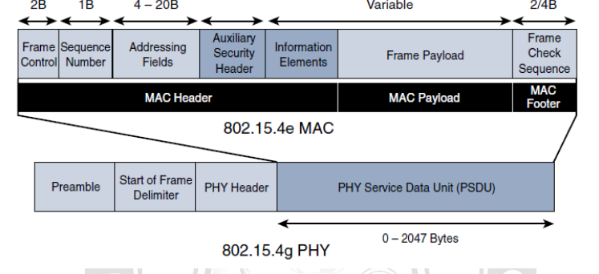
Cont..
IEEE 802.15.4g and 802.15.4e
MAC layer:

Slide 41
Cont..
IEEE 802.15.4g and 802.15.4e
Topology :
Deployments of IEEE 802.15.4g-2012 are mostly based on a mesh topology. This is because a mesh topology is typically the best choice for use cases in the industrial and smart cities areas where 802.15.4g-2012 is applied.
A mesh topology allows deployments to be done in urban or rural areas, expanding the distance between nodes that can relay the traffic of other nodes.
Security :
Both IEEE 802.15.4g and 802.15.4e inherit their security attributes from the IEEE 802.15.4-2006 specification. Therefore, encryption is provided by AES, with a 128-bit key.
In addition to the Auxiliary Security Header field initially defined in 802.15.4-2006, a secure acknowledgement and a secure Enhanced Beacon field complete the MAC layer security.

Slide 42
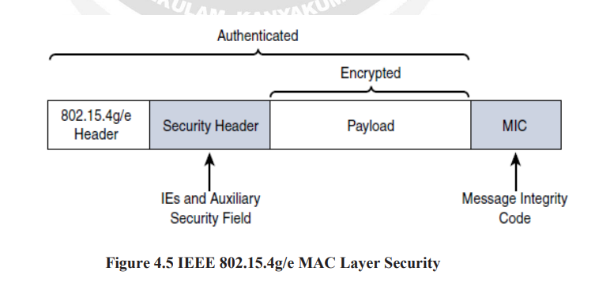
Cont..
IEEE 802.15.4g and 802.15.4e
Security :

Slide 43
Cont..
IEEE 802.11ah
In unconstrained networks, IEEE 802.11 Wi-Fi is certainly the most successfully deployed wireless technology.
This standard is a key IoT wireless access technology, either for connecting endpoints such as fog computing nodes, high-data-rate sensors, and audio or video analytics devices or for deploying Wi-Fi backhaul infrastructures, such as outdoor Wi-Fi mesh in smart cities, oil and mining, or other environments.
Wi-Fi lacks sub-GHz support for better signal penetration, low power for battery-powered nodes, and the ability to support a large number of devices.
•Sensors and meters covering a smart grid: Meter to pole, environmental/agricultural monitoring, industrial process sensors, indoor healthcare system and fitness sensors, home and building automation sensors.
•Backhaul aggregation of industrial sensors and meter data: Potentially connecting IEEE 802.15.4g sub networks
•Extended range Wi-Fi: For outdoor extended-range hotspot or cellular traffic offloading when distances already covered by IEEE 802.11a/b/g/n/ac are not good enough

Slide 44
Cont..
IEEE 802.11ah
Standardization and Alliances:
The 802.11ah specification would operate in unlicensed sub-GHz frequency bands, similar to IEEE 802.15.4 and other LPWA technologies.
The industry organization that promotes Wi-Fi certifications and interoperability for 2.4 GHz and 5 GHz products is the Wi-Fi Alliance.
For the 802.11ah standard, the Wi-Fi Alliance defined a new brand called Wi-Fi HaLow.
You can think of Wi-Fi HaLow as a commercial designation for products incorporating IEEE 802.11ah technology.

Slide 45
Cont..
IEEE 802.11ah
Physical layer:
IEEE 802.11ah essentially provides an additional 802.11 physical layer operating in unlicensed sub-GHz.
Based on OFDM modulation, IEEE 802.11ah uses channels of 2, 4, 8, or 16 MHz (and also 1 MHz for low bandwidth transmission).
This is one-tenth of the IEEE 802.11ac channels, resulting in one-tenth of the corresponding data rates of IEEE 802.11ac. The IEEE 802.11ac standard is a high-speed wireless LAN protocol at the 5 GHz band that is capable of speeds up to 1 Gbps.
While 802.11ah does not approach this transmission speed (as it uses one-tenth of 802.11ac channel width, it reaches one-tenth of 802.11ac speed), it does provide an extended range for its lower speed data.
For example, at a data rate of 100 kbps, the outdoor transmission range for IEEE 802.11ah is expected to be 0.62 mile.

Slide 46
Cont..
IEEE 802.11ah
MAC layer:
The IEEE 802.11ah MAC layer is optimized to support the new sub-GHz Wi-Fi PHY while providing low power consumption and the ability to support a larger number of endpoints.
Enhancements and features specified by IEEE 802.11ah for the MAC layer include the following:
• Number of devices: Has been scaled up to 8192 per access point.
• MAC header: Has been shortened to allow more efficient communication.
• Null data packet (NDP) support: is extended to cover several control and management frames. Relevant information is concentrated in the PHY header and the additional overhead associated with decoding the MAC header and data payload is avoided.
•Grouping and sectorization: Enables an AP to use sector antennas and also group stations (distributing a group ID). In combination with RAW and TWT, this mechanism reduces contention in large cells with many clients by restricting which group, in which sector, can contend during which time window.

Slide 47
Cont..
IEEE 802.11ah
MAC layer:
Enhancements and features specified by IEEE 802.11ah for the MAC layer include the following:
•Restricted access window (RAW): Is a control algorithm that avoids simultaneous transmissions when many devices are present and provides fair access to the wireless network.
•Target wake time (TWT): Reduces energy consumption by permitting an access point to define times when a device can access the network. This allows devices to enter a low-power state until their TWT time arrives.
•Speed frame exchange: Enables an AP and endpoint to exchange frames during a reserved transmit opportunity (TXOP).
The 802.11ah MAC layer is focused on power consumption and mechanisms to allow low-power Wi-Fi stations to wake up less often and operate more efficiently.
This sort of MAC layer is ideal for IoT devices that often produce short, low-bit-rate transmissions.

Slide 48
Cont..
IEEE 802.11ah
MAC layer:
While IEEE 802.11ah is deployed as a star topology, it includes a simple hops relay operation to extend its range. This relay option is not capped, but the IEEE 802.11ah task group worked on the assumption of two hops. It allows one 802.11ah device to act as an intermediary and relay data to another.
Sectorization is a technique that involves partitioning the coverage area into several sectors to get reduced contention within a certain sector. This technique is useful for limiting collisions in cells that have many clients.

Slide 49
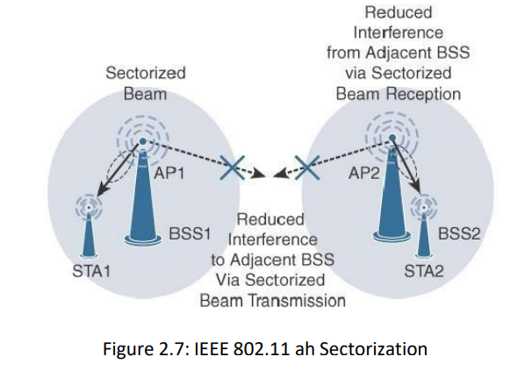
Cont..
IEEE 802.11ah
MAC layer:

Slide 50
Cont..
IEEE 802.11ah
Security:
No additional security has been identified for IEEE 802.11ah compared to other IEEE 802.11 specifications.
Competitive Technologies:
Competitive technologies to IEEE 802.11ah are IEEE 802.15.4 and IEEE 802.15.4e.

Slide 51
Cont..
LORA WAN
In recent years, a new set of wireless technologies known as Low-Power Wide-Area (LPWA) has received a lot of attention from the industry and press. Particularly well adapted for long-range and battery-powered endpoints.
Standardization and Alliances:
Initially, LoRa was a physical layer, or Layer 1, modulation that was developed by a French company named Cycleo.
Optimized for long range, two-way communications and low power consumption, the technology evolved from Layer 1 to a broader scope through the creation of the LoRa Alliance.
Semtech LoRa as a Layer 1 PHY modulation technology is available through multiple chipset vendors. To differentiate from the physical layer modulation known as LoRa, the LoRa Alliance uses the term LoRaWAN to refer to its architecture and its specifications that describe end-to-end LoRaWAN communications and protocols.

Slide 52
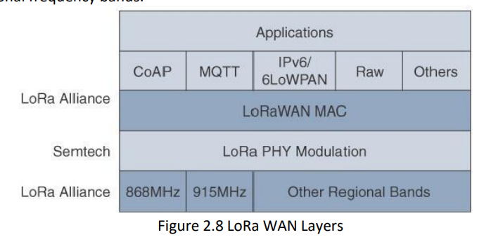
Cont..
LORA WAN
Standardization and Alliances:
In this figure, notice that Semtech is responsible for the PHY layer, while the LoRa Alliance handles the MAC layer and regional frequency bands.

Slide 53
Cont..
LORA WAN
Physical layer:
Semtech LoRa modulation is based on chirp spread spectrum modulation, which trades a lower data rate for receiver sensitivity to significantly increase the communication distance.
It allows demodulation below the noise floor, offers robustness to noise and interference, and manages a single channel occupation by different spreading factors. This enables LoRa devices to receive on multiple channels in parallel.
A LoRa gateway is deployed as the center hub of star network architecture. It uses multiple transceivers and channels and can demodulate multiple channels at once or even demodulate multiple signals on the same channel simultaneously.

Slide 54
Cont..
LORA WAN
Physical layer:
LoRa gateways serve as a transparent bridge relaying data between endpoints, and the endpoints use a single-hop wireless connection to communicate with one or many gateways.
The data rate in LoRaWAN varies depending on the frequency bands and adaptive data rate (ADR).
ADR is an algorithm that manages the data rate and radio signal for each endpoint.
The ADR algorithm ensures that packets are delivered at the best data rate possible and that network performance is both optimal and scalable.

Slide 55
Cont..
LORA WAN
Physical layer:
Endpoints close to the gateways with good signal values transmit with the highest data rate, which enables a shorter transmission time over the wireless network, and the lowest transmit power.
Meanwhile, endpoints at the edge of the link budget communicate at the lowest data rate and highest transmit power.
An important feature of LoRa is its ability to handle various data rates via the spreading factor. Devices with a low spreading factor (SF) achieve less distance in their communications but transmit at faster speeds, resulting in less airtime. A higher SF provides slower transmission rates but achieves a higher reliability at longer distances.

Slide 56
Cont..
LORA WAN
MAC layer:
The MAC layer is defined in the LoRaWAN specification. This layer takes advantage of the LoRa physical layer and classifies LoRaWAN endpoints to optimize their battery life and ensure downstream communications to the LoRaWAN endpoints.

Slide 57
Cont..
LORA WAN
MAC layer:
The LoRaWAN specification documents three classes of LoRaWAN devices:
• Class A: This class is the default implementation. Optimized for battery-powered nodes, it allows bidirectional communications, where a given node is able to receive downstream traffic after transmitting. Two receive windows are available after each transmission.
• Class B: This class was designated “experimental” in LoRaWAN 1.0.1 until it can be better defined. A Class B node or endpoint should get additional receive windows compared to Class A, but gateways must be synchronized through a beaconing process.
• Class C: This classis particularly adapted for powered nodes. This classification enables a node to be continuously listening by keeping it’s receive window open when not transmitting.

Slide 58
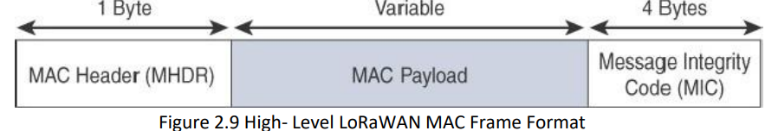
Cont..
LORA WAN
MAC layer:
The MAC payload size depends on the frequency band and the data rate, ranging from 59 to 230 bytes for the 863–870 MHz band and 19 to 250 bytes for the 902–928 MHz band.

Slide 59
Cont..
LORA WAN
MAC layer:
The MAC payload size depends on the frequency band and the data rate, ranging from 59 to 230 bytes for the 863–870 MHz band and 19 to 250 bytes for the 902–928 MHz band.
LoRaWAN devices use join request and join accept messages for over-the-air (OTA) activation and joining the network. The other message types are unconfirmed data up/down and confirmed data up/down.
A “confirmed” message is one that must be acknowledged, and “unconfirmed” signifies that the end device does not need to acknowledge.

Slide 60
Cont..
LORA WAN
MAC layer:
“up/down” is simply a directional notation identifying whether the message flows in the uplink or downlink path.
Uplink messages are sent from endpoints to the network server and are relayed by one or more LoRaWAN gateways.
Downlink messages flow from the network server to a single endpoint and are relayed by only a single gateway.

Slide 61
Cont..
LORA WAN
MAC layer:
LoRaWAN endpoints are uniquely addressable through a variety of methods, including the following:
• An endpoint can have a global end device ID or DevEUI represented as an IEEE EUI- 64 address.
• An endpoint can have a global application ID or AppEUI represented as an IEEE EUI- 64 address that uniquely identifies the application provider, such as the owner, of the end device.
• In a LoRaWAN network, endpoints are also known by their end device address, known as a DevAddr, a 32-bit address. The 7 most significant bits are the network identifier (NwkID), which identifies the LoRaWAN network. The 25 least significant bits are used as the network address (NwkAddr) to identify the endpoint in the network.

Slide 62
Cont..
LORA WAN
Topology:
LoRaWAN topology is often described as a “star of stars” topology. As shown in Figure, the infrastructure consists of endpoints exchanging packets through gateways acting as bridges, with a central LoRaWAN network server.
Gateways connect to the backend network using standard IP connections, and endpoints communicate directly with one or more gateways.

Slide 63
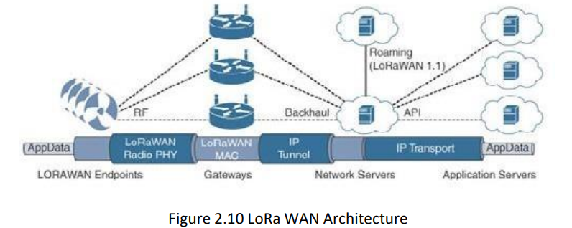
Cont..
LORA WAN
Topology:

Slide 64
Cont..
LORA WAN
Topology:
The LoRaWAN network server manages the data rate and radio frequency (RF) of each endpoint through the adaptive data rate (ADR) algorithm.
ADR is a key component of the network scalability, performance, and battery life of the endpoints.
The LoRaWANnetwork server forwards application data to the application servers, as depicted in Figure .
In future versions of the LoRaWAN specification, roaming capabilities between LoRaWAN network servers will be added. These capabilities will enable mobile endpoints to connect and roam between different LoRaWAN network infrastructures.

Slide 65
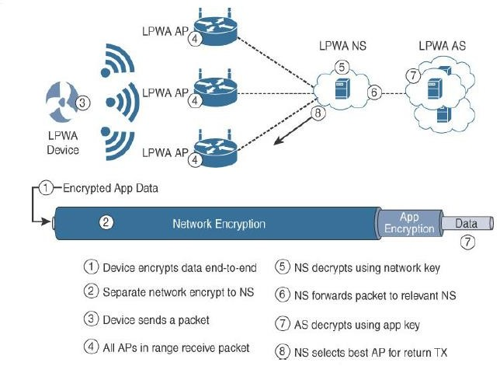
Cont..
LORA WAN
Security:
LoRaWAN endpoints must implement two layers of security, protecting communications and data privacy across the network.

Slide 66
Cont..
LORA WAN
Security:
The first layer, called “network security” but applied at the MAC layer, guarantees the authentication of the endpoints by the LoRaWAN network server.
Each endpoint implements a network session key (NwkSKey), used by both itself and the LoRaWAN network server.
The second layer is an application session key (AppSKey), which performs encryption and decryption functions between the endpoint and its application server.
Endpoints receive their AES-128 application key (AppKey) from the application owner. This key is most likely derived from an application-specific root key exclusively known to and under the control of the application provider.

Slide 67
Cont..
LORA WAN
Competitive Technologies:
LPWA solutions and technologies are split between unlicensed and licensed bands.
The licensed-band technologies are dedicated to mobile service providers that have acquired spectrum licenses.
In addition, several technologies are targeting the unlicensed- band LPWA market to compete against LoRaWAN.
The LPWA market is quickly evolving.

Slide 68
Cont..
NETWORK LAYER
Constrained Nodes:
In IoT solutions, different classes of devices coexist. Depending on its functions in a network, “thing” architecture may or may not offer similar characteristics compared to a generic PC or server in an IT environment.
Another limit is that this network protocol stack on an IoT node may be required to communicate through an unreliable path.
Even if a full IP stack is available on the node, this causes problems such as limited or unpredictable throughput and low convergence when a topology change occurs.
power consumption is a key characteristic of constrained nodes. Many IoT devices are battery powered, with lifetime battery requirements varying from a few months to 10+ years.

Slide 69
Cont..
NETWORK LAYER
Constrained Nodes:
IoT constrained nodes can be classified as follows:
• Devices that are very constrained in resources, may communicate infrequently to transmit a few bytes, and may have limited security and management capabilities: This drives the need for the IP adaptation model, where nodes communicate through gateways and proxies.
• Devices with enough power and capacities to implement a stripped-down IP stack or non- IP stack: In this case, you may implement either an optimized IP stack and directly communicate with application servers (adoption model) or go for an IP or non-IP stack and communicate through gateways and proxies (adaptation model).

Slide 70
Cont..
NETWORK LAYER
Constrained Nodes:
IoT constrained nodes can be classified as follows:
• Devices that are similar to generic PCs in terms of computing and power resources but have constrained networking capacities, such as bandwidth: These nodes usually implement a full IP stack (adoption model), but network design and application behaviors must cope with the bandwidth constraints.

Slide 71
Cont..
NETWORK LAYER
Constrained Networks:
Constrained networks are often referred to as low-power and lossy networks (LLNs). Lossy in this context refers to network unreliability that is caused by disruptions in the data flow or packet loss.
Constrained networks have unique characteristics and requirements. In contrast with typical IP networks, where highly stable and fast links are available, constrained networks are limited by low-power, low bandwidth links (wireless and wired).
Unstable link layer environments create other challenges in terms of latency and control plane reactivity (low bandwidth can lead to a network collapse).
Control plane traffic must also be kept at a minimum; otherwise, it consumes the bandwidth that is needed by the data traffic.

Slide 72
Cont..
NETWORK LAYER
IP Versions:
The IETF (Internet Engineering Task Force) has been working on transitioning the Internet from IP version 4 to IP version 6. The main driving force has been the lack of address space in IPv4 as the Internet has grown. IPv6 has a much larger range of addresses that should not be exhausted for the foreseeable future.
Today, both versions of IP run over the Internet, but most traffic is still IPv4 based.

Slide 73
Cont..
NETWORK LAYER
IP Versions:
The following are some of the main factors applicable to IPv4 and IPv6 support in an IoT solution:
• Application Protocol: IoT devices implementing Ethernet or Wi-Fi interfaces can communicate over both IPv4 and IPv6, but the application protocol may dictate the choice of the IP version. For example, SCADA protocols such as DNP3/IP (IEEE 1815), Modbus TCP, or the IEC 60870-5-104 standards are specified only for IPv4. So, there are no known production implementations by vendors of these protocols over IPv6 today. For IoT devices with application protocols defined by the IETF, such as HTTP/HTTPS, CoAP, MQTT, and XMPP, both IP versions are supported. The selection of the IP version is only dependent on the implementation.

Slide 74
Cont..
NETWORK LAYER
IP Versions:
The following are some of the main factors applicable to IPv4 and IPv6 support in an IoT solution:
• Cellular Provider and Technology: IoT devices with cellular modems are dependent on the generation of the cellular technology as well as the data services offered by the provider. For the first three generations of data services—GPRS, Edge, and 3G— IPv4 is the base protocol version. Consequently, if IPv6 is used with these generations, it must be tunneled over IPv4. On 4G/LTE networks, data services can use IPv4 or IPv6 as a base protocol, depending on the provider.

Slide 75
Cont..
NETWORK LAYER
IP Versions:
The following are some of the main factors applicable to IPv4 and IPv6 support in an IoT solution:
• Serial Communications: Many legacy devices in certain industries, such as manufacturing and utilities, communicate through serial lines. Data is transferred using either proprietary or standards based protocols, such as DNP3, Modbus, or IEC 60870-5-101.
This local router then forwards the serial traffic over IP to the central server for processing. Encapsulation of serial protocols over IP leverages mechanisms such as raw socket TCP or UDP. While raw socket sessions can run over both IPv4 and IPv6, current implementations are mostly available for IPv4 only.

Slide 76
Cont..
NETWORK LAYER
IP Versions:
The following are some of the main factors applicable to IPv4 and IPv6 support in an IoT solution:
• IPv6 Adaptation Layer: IPv6-only adaptation layers for some physical and data link layers for recently standardized IoT protocols support only IPv6. While the most common physical and data link layers(Ethernet, Wi-Fi, and so on)stipulate adaptation layers for both versions, newer technologies, such as IEEE 802.15.4 (Wireless Personal Area Network), IEEE 1901.2, and ITU G.9903 (Narrowband Power Line Communications) only have an IPv6 adaptation layer specified. This means that any device implementing a technology that requires an IPv6 adaptation layer must communicate over an IPv6-only sub network. This is reinforced by the IETF routing protocol for LLNs, RPL, which is IPv6 only.

Slide 77
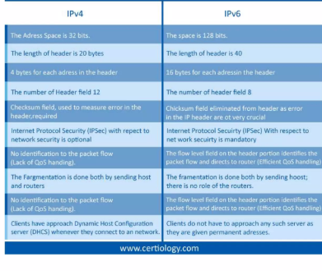
Cont..
NETWORK LAYER

Slide 78
Cont..
NETWORK LAYER
Optimising IP for IoT:
While the Internet Protocol is key for a successful Internet of Things, constrained nodes and constrained networks mandate optimization at various layers and on multiple protocols of the IP architecture.
The following sections introduce some of these optimizations already available. Figure highlights the TCP/IP layers where optimization is applied.

Slide 79
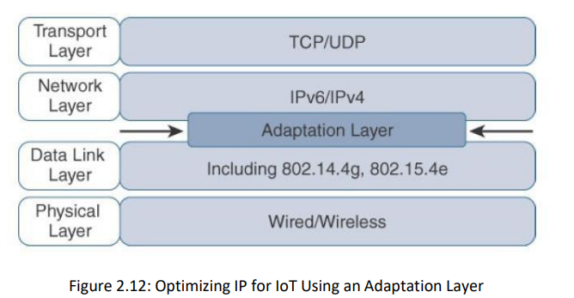
Cont..
NETWORK LAYER
Optimising IP for IoT:

Slide 80
Cont..
NETWORK LAYER
From 6LoWPAN to 6Lo:
In the IP architecture, the transport of IP packets over any given Layer 1 (PHY) and Layer 2 (MAC) protocol must be defined and documented. The model for packaging IP into lower-layer protocols is often referred to as an adaptation layer.
The main examples of adaptation layers optimized for constrained nodes or “things” are the ones under the 6LoWPAN working group and its successor, the 6Lo working group.
The initial focus of the 6LoWPAN working group was to optimize the transmission of IPv6 packets over constrained networks such as IEEE 802.15.4.
Figure shows an example of an IoT protocol stack using the 6LoWPAN adaptation layer beside the well- known IP protocol stack for reference.

Slide 81
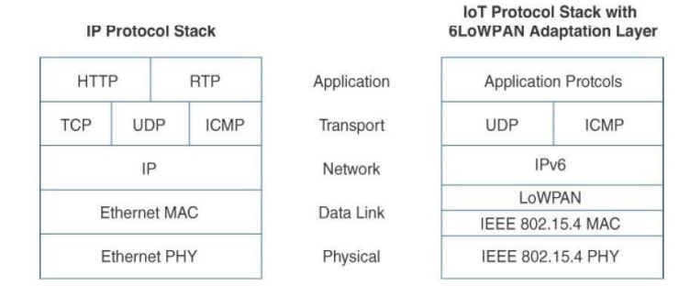
Cont..
NETWORK LAYER
From 6LoWPAN to 6Lo:
The 6LoWPAN working group published several RFCs, but RFC 4994 is foundational because it defines frame headers for the capabilities of header compression, fragmentation, and mesh addressing.

Slide 82
Cont..
NETWORK LAYER
Header compression:
IPv6 header compression for 6LoWPAN was defined initially in RFC 4944 and subsequently updated by RFC 6282.
This capability shrinks the size of IPv6’s 40-byte headers and User Datagram Protocol’s (UDP’s) 8-byte headers down as low as 6 bytes combined in some cases.
Note that header compression for 6LoWPAN is only defined for an IPv6 header and not IPv4

Slide 83
Cont..
NETWORK LAYER
Header compression:
IPv6 header compression for 6LoWPAN was defined initially in RFC 4944 and subsequently updated by RFC 6282.
This capability shrinks the size of IPv6’s 40-byte headers and User Datagram Protocol’s (UDP’s) 8-byte headers down as low as 6 bytes combined in some cases.
Note that header compression for 6LoWPAN is only defined for an IPv6 header and not IPv4

Slide 84
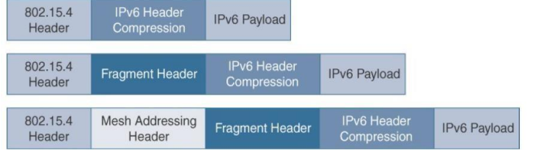
Cont..
NETWORK LAYER
Header compression:

Slide 85
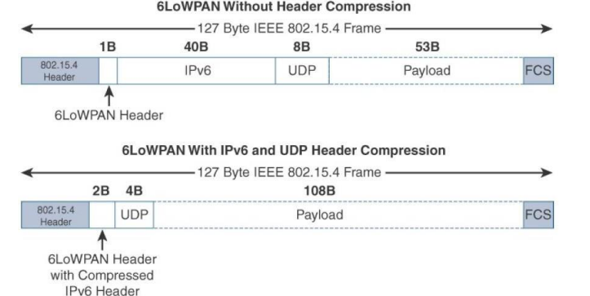
Cont..
NETWORK LAYER
Header compression:

Slide 86
Cont..
NETWORK LAYER
Fragmentation:
The maximum transmission unit (MTU) for an IPv6 network must be at least 1280 bytes. The term MTU defines the size of the largest protocol data unit that can be passed. For IEEE 802.15.4, 127 bytes is the MTU.
This is a problem because IPv6, with a much larger MTU, is carried inside the 802.15.4 frame with a much smaller one. To remedy this situation, large IPv6 packets must be fragmented across multiple 802.15.4 frames at Layer 2.
The fragment header utilized by 6LoWPAN is composed of three primary fields: Datagram Size, Datagram Tag, and Datagram Offset.
The 1-byte Datagram Size field specifies the total size of the unfragmented payload. Datagram Tag identifies the set of fragments for a payload. Finally, the Datagram Offset field delineates how far into a payload a particular fragment occurs.

Slide 87
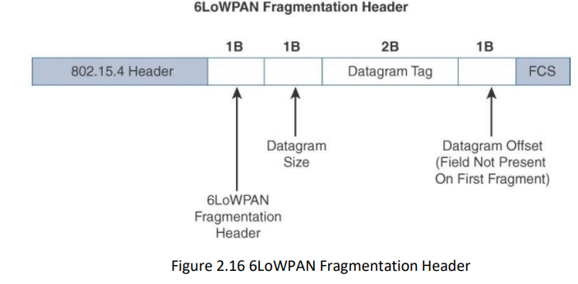
Cont..
NETWORK LAYER
Header compression:

Slide 88
Cont..
NETWORK LAYER
Mesh Addressing:
The purpose of the 6LoWPAN mesh addressing function is to forward packets over multiple hops. Three fields are defined for this header: Hop Limit, Source Address, and Destination Address.
Analogous to the IPv6 hop limit field, the hop limit for mesh addressing also provides an upper limit on how many times the frame can be forwarded.
Each hop decrements this value by 1 as it is forwarded. Once the value hits 0, it is dropped and no longer forwarded.

Slide 89
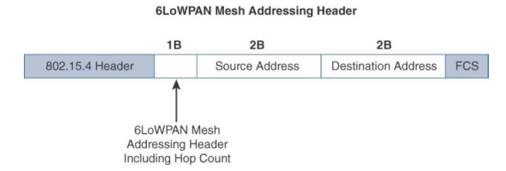
Cont..
NETWORK LAYER
Mesh Addressing:

Slide 90
Cont..
APPLICATION TRANSPORT METHODS
SCADA:
Designed decades ago, SCADA is an automation control system that was initially implemented without IP over serial links, before being adapted to Ethernet and IPv4.
At a high level, SCADA systems collect sensor data and telemetry from remote devices, while also providing the ability to control them.
SCADA networks can be found across various industries, but you find SCADA mainly concentrated in the utilities and manufacturing/industrial verticals.
Within these specific industries, SCADA commonly uses certain protocols for communications between devices and applications.

Slide 91
Cont..
APPLICATION TRANSPORT METHODS
SCADA:
These protocols go back decades and are serial based. So, transporting them over current IoT and traditional networks requires that certain accommodations be made from both protocol and implementation perspectives.
The rapid adoption of Ethernet networks in the industrial world drove the evolution of SCADA application layer protocols.
Benefits of this move to Ethernet and IP include the ability to leverage existing equipment and standards while integrating seamlessly the SCADA sub networks to the corporate WAN infrastructures.
DNP3 (Distributed Network Protocol ) protocols have adopted and evolved to utilize IP and TCP/UDP as both networking and transporting mechanisms.

Slide 92
Cont..
APPLICATION TRANSPORT METHODS
SCADA:
Like many of the other SCADA protocols, DNP3 is based on a master/slave (control center / remote device) relationship.
Slave monitors and collects data from devices that indicate their state, such as whether a circuit breaker is on or off, and take measurements, including voltage, current, temperature and so on.
This data is then transmitted to the master when it is requested, or events and alarms can be sent in an asynchronous manner. The master also issues control commands, such as to start a motor or reset a circuit breaker, and logs the incoming data.

Slide 93
Cont..
APPLICATION TRANSPORT METHODS
SCADA:
Connection management links the DNP3 layers with the IP layers in addition to the configuration parameters and methods necessary for implementing the network connection.
The master side initiates connections by performing a TCP active open. The outstation listens for a connection request by performing a TCP passive open.
Master stations may parse multiple DNP3 data link layer frames from a single UDP datagram, while DNP3 data link layer frames cannot span multiple UDP data grams.

Slide 94
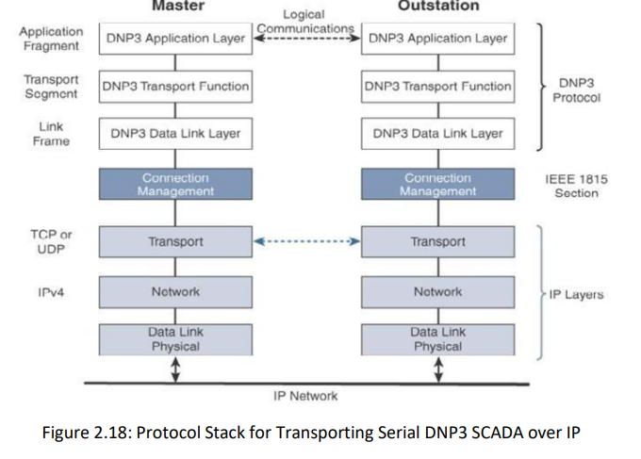
Cont..
APPLICATION TRANSPORT METHODS
SCADA:

Slide 95
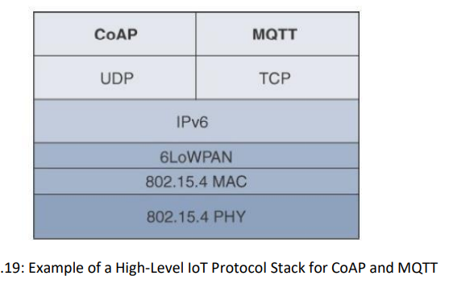
Cont..
APPLICATION LAYER PROTOCOLS
When considering constrained networks and/or a large-scale deployment of constrained nodes, verbose web-based and data model protocols, may be too heavy for IoT applications.
To address this problem, the IoT industry is working on new lightweight protocols that are better suited to large numbers of constrained nodes and networks.
There are a few exceptions, you will almost always find CoAP deployed over UDP and MQTT running over TCP.

Slide 96
Cont..
APPLICATION LAYER PROTOCOLS
CoAP:
The CoAP framework defines simple and flexible ways to manipulate sensors and actuators for data or device management.
The CoAP messaging model is primarily designed to facilitate the exchange of messages over UDP between endpoints, including the secure transport protocol Datagram Transport Layer Security (DTLS).
RFC 7252 provides more details on securing CoAP with DTLS. It specifies how a CoAP endpoint is provisioned with keys and a filtering list.
Four security models are defined: NoSec, PreSharedKey, RawPublicKey, and Certificate. The NoSec and RawPublicKey implementations are mandatory.

Slide 97
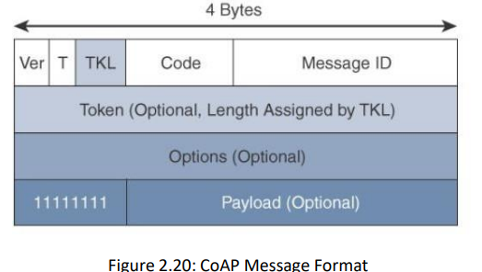
Cont..
APPLICATION LAYER PROTOCOLS
CoAP:
CoAP message is composed of a short fixed-length Header field (4 bytes), a variable-length but mandatory Token field (0–8 bytes), Options fields if necessary, and the Payload field.
From the fig the CoAP message format is relatively simple and flexible. It allows CoAP to deliver low overhead, which is critical for constrained networks, while also being easy to parse and process for constrained devices.

Slide 98
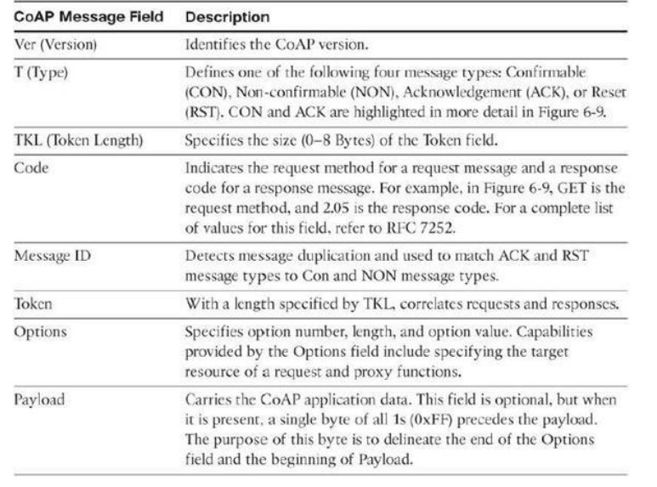
Cont..
APPLICATION LAYER PROTOCOLS
CoAP:

Slide 99
Cont..
APPLICATION LAYER PROTOCOLS
CoAP:
CoAP can run over IPv4 or IPv6. However, it is recommended that the message fit within a single IP packet and UDP payload to avoid fragmentation.
CoAP doesn’t rely on IP fragmentation but defines (in RFC 7959) a pair of block options for transferring multiple blocks of information from a resource representation in multiple request/response pairs.
CoAP defines four types of messages: confirmable, non-confirmable, acknowledgement, and reset.

Slide 100
Cont..
APPLICATION LAYER PROTOCOLS
CoAP:
For IPv6, with the default MTU size being 1280 bytes and allowing for no fragmentation across nodes, the maximum CoAP message size could be up to 1152 bytes, including 1024 bytes for the payload.
In the case of IPv4, as IP fragmentation may exist across the network, implementations should limit themselves to more conservative values and set the IPv4 Don’t Fragment (DF) bit.
CoAP communications across an IoT infrastructure can take various paths. Connections can be between devices located on the same or different constrained networks or between devices and generic Internet or cloud servers, all operating over IP.

Slide 101
Cont..
APPLICATION LAYER PROTOCOLS
CoAP:
Proxy mechanisms are also defined, and RFC 7252 details a basic HTTP mapping for CoAP. As both HTTP and CoAP are IP-based protocols, the proxy function can be located practically anywhere in the network, not necessarily at the border between constrained and non constrained networks.
Just like HTTP, CoAP is based on the REST architecture, but with a “thing” acting as both the client and the server. Through the exchange of asynchronous messages, a client requests an action via a method code on a server resource.
A uniform resource identifier (URI) localized on the server identifies this resource. The server responds with a response code that may include a resource representation. The CoAP request/response semantics include the methods GET, POST, PUT, and DELETE.

Slide 102
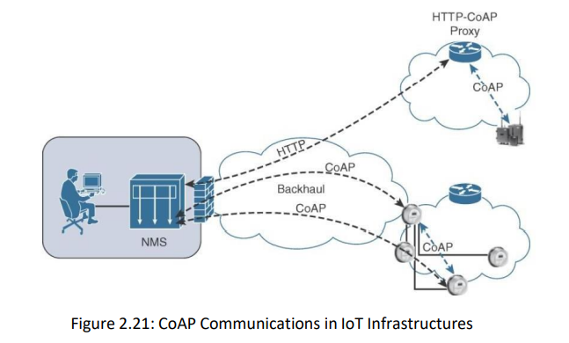
Cont..
APPLICATION LAYER PROTOCOLS
CoAP:

Slide 103
Cont..
APPLICATION LAYER PROTOCOLS
MQTT:
At the end of the 1990s, engineers from IBM and Arcom (acquired in 2006 by Eurotech) were looking for a reliable, lightweight, and cost-effective protocol to monitor and control a large number of sensors and their data from a central server location, as typically used by the oil and gas industries.
Their research resulted in the development and implementation of the Message Queuing Telemetry Transport (MQTT) protocol.
The selection of a client/server and publish/subscribe framework based on the TCP/IP architecture.

Slide 104
Cont..
APPLICATION LAYER PROTOCOLS
MQTT:
An MQTT client can act as a publisher to send data (or resource information) to an MQTT server acting as an MQTT message broker.
In the example illustrated in Figure the MQTT client on the left side is a temperature (Temp) and relative humidity (RH) sensor that publishes its Temp/RH data.
The MQTT server (or message broker) accepts the network connection along with application messages, such as Temp/RH data, from the publishers.
It also handles the subscription and unsubscription process and pushes the application data to MQTT clients acting as subscribers.

Slide 105
Cont..
APPLICATION LAYER PROTOCOLS
MQTT:
The application on the right side of Figure 2.22 is an MQTT client that is a subscriber to the Temp/RH data being generated by the publisher or sensor on the left. This model, where subscribers express a desire to receive information from publishers, is well known.
With MQTT, clients can subscribe to all data (using a wildcard character) or specific data from the information tree of a publisher. In addition, the presence of a message broker in MQTT decouples the data transmission between clients acting as publishers and subscribers.
In fact, publishers and subscribers do not even know (or need to know) about each other.

Slide 106
Cont..
APPLICATION LAYER PROTOCOLS
MQTT:
A benefit of having this decoupling is that the MQTT message broker ensures that information can be buffered and cached in case of network failures.
This also means that publishers and subscribers do not have to be online at the same time. MQTT control packets run over a TCP transport using port 1883.
TCP ensures an ordered, lossless stream of bytes between the MQTT client and the MQTT server. Optionally, MQTT can be secured using TLS on port 8883, and WebSocket (defined in RFC 6455) can also be used.

Slide 107
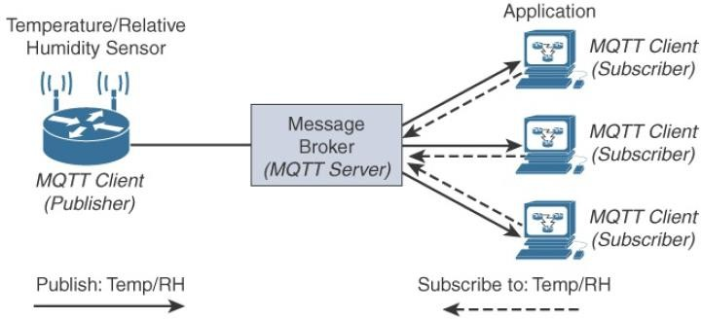
Cont..
APPLICATION LAYER PROTOCOLS
MQTT:

Slide 108
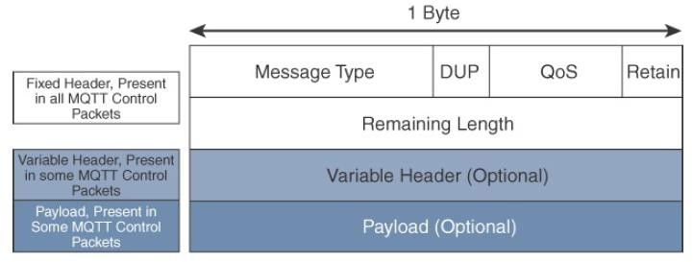
Cont..
APPLICATION LAYER PROTOCOLS
MQTT:

Slide 109
Cont..
APPLICATION LAYER PROTOCOLS
MQTT:
MQTT is a lightweight protocol because each control packet consists of a 2-byte fixed header with optional variable header fields and optional payload. You should note that a control packet can contain a payload up to 256 MB. Figure provides an overview of the MQTT message format.
Compared to the CoAP message format, MQTT contains a smaller header of 2 bytes compared to 4 bytes for CoAP. The first MQTT field in the header is Message Type, which identifies the kind of MQTT packet within a message. Fourteen different types of control packets are specified in MQTT version 3.1.1. Each of them has a unique value that is coded into the Message Type field. Note that values 0 and 15 are reserved.

Slide 110
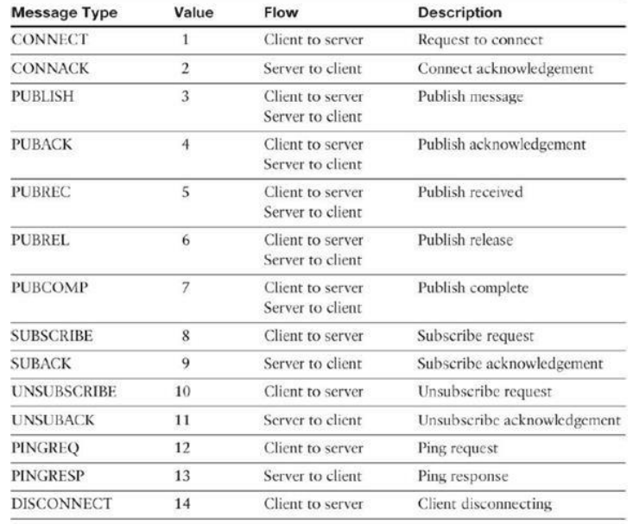
Cont..
APPLICATION LAYER PROTOCOLS
MQTT:

Slide 111
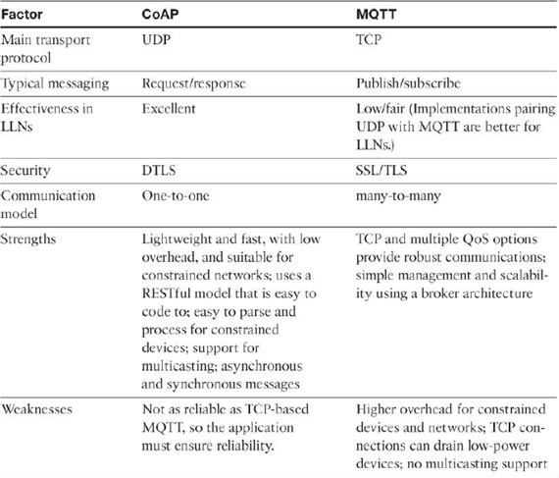
Cont..
APPLICATION LAYER PROTOCOLS
Differences between CoAP & MQTT:

